Slide 1
ANAEMIA IN PREGNANCY

Slide 2
INTRODUCTION
Anaemia is a global problem.
It is a major health problem in India .
It is the most common haematological abnormality diagnosed in pregnancy.
Its Prevalence in India is about 60% and may increase to 80% during pregnancy.
It directly or indirectly contributes to a significant proportions (about 40%) of maternal deaths.
It antedates the conception ,often aggravated by pregnancy and delivery.
It is most commonly due to iron deficiency and occasionally by other complex mechanisms.

Slide 3
According to WHO anaemia in pregnancy is defined when hemoglobin of pregnant woman is less than 11gm% and hematocrit is less than 0.33 (33%).¹
Centre for disease control (CDC) of USA (1990) has recommended level of hemoglobin as 11gm% in first and third trimester where as 10.5gm% for second trimester of pregnancy.

Slide 4
The Indian Council of Medical Research Categories of Anaemia.
Category | Anaemia severity | Hemoglobin level (gm/dl)
1 | Mild | 10.0-10.9
2 | Moderate | 7.0-10.0
3 | Severe | <7.0
4 | Very severe (Decompensated) | <4.0

Slide 5
According to WHO 2002
Mild / moderate anaemia - 7 - 10.9gm%
Severe anaemia - < 7gm%

Slide 6
CLASSIFICATION OF ANAEMIA DURING PREGNANCY:
Physiological anaemia of pregnancy
Anaemia of under production
Nutritional - Iron deficiency
Folate deficiency
Vitamin B12 deficiency
Vitamin A deficiency
Pure red cell aplasia
Aplastic anaemia
Anaemia due to blood loss -
Acute; early trimester bleeding, APH
Chronic; hookworm and other parasitic infection
Secondary to infections like malaria
Hemolytic anaemia –
Congenital; G6PD deficiency and hereditary spherocytosis
Acquired; micro angiopathic hemolytic anaemia. Acquired immune hemolytic anaemia
Hemoglobinopathies –
Sickle cell trait
Sickle cell disease
Thalassemia
Others like HbE, HbC, HbH etc

Slide 7
MORPHOLOGIC CLASSIFICATION:
MICROCYTIC: Iron deficiency, sideroblastic anaemia, chronic infection
NORMOBLASTIC: Anaemia due to hemorrhage or haemolysis.
MACROCYTIC: Megaloblastic anaemia due to folate & vitamin B12 deficiency.

Slide 8
Physiological changes in blood indices during pregnancy
Characteristics | Normal adult woman | 32-34 weeks gestation | Increased /decreased
Plasma volume (ml) | 2600 | 3850 | 1250 ml
Red cell mass (ml) | 1400 | 1640 (without iron supplement) 1800 (with iron supplement) | 240 ml
Hemoglobin (g/dl) | 12-14 | 11-12 | Decreased
Red blood cells (10⁶/cumm) | 4-5 | 3-4.5 | Decreased
Packed cell volume (PCV) | 0.36 -0.44 | 0.32-0.36 | Decreased
Mean corpuscular, volume (fl) (MCV) | 80-97 | 70-95 | Decreased
Mean Corpuscular hemoglobin (pg) (MCH) | 27-33 | 26-31 | Decreased
Mean corpuscular Hemoglobin concentration (%) (MCHC) | 32-36 | 30-35 | Decreased
Serum iron (mg/dl)(Fc) | 60-175 | 60-75 | Decreased
Total iron binding capacity (mg/dl) (TIBC) | 300-350 | 350-400 | Increased
TIBC saturated (%) | 30 | 15 | Decreased
Requirements of iron (mg/dl) | 1.5-2 | 4 | Increased

Slide 9
Criteria for Physiological anaemia:
The lower limit of physiological anaemia during the second half of pregnancy should fulfill the following haematological values.
Hb : 10gm%
RBC Count : 32 Millions / cum
PCV : 30%
RBC Morphology: Normal morphology on peripheral smear.

Slide 10
Predisposing factors for anaemia during pregnancy:
Increased demand of iron, folia acid and vitamin B12.
Diminished intake (poor diet, morning sickness)
Disturbed metabolism (pregnancy induced depression of bone marrow)
Infection (malaria, asymptomatic bacteriuria, piles, worm infestation)
Pre pregnant state of iron reserves
Twin gestation and repeated pregnancies without adequate spacing(multiparity)
Abnormal pregnancy states like molar pregnancy
Anti folate medications such as (antiepileptic drugs (Phenytoin, Phenobarbitone, Primidone), pyrimethamine and trimethoprim, aggravates the deficiency.

Slide 11
NUTRITIONAL ANAEMIA

Slide 12
IRON DEFICIENCY ANAEMIA
Iron deficiency anaemia is the commonest nutritional anaemia followed by folic acid deficiency and very rarely vitamin B12 (Cyanocobalamin) deficiency.

Slide 13
Iron absorption
Absorption:Duodenum
Absorption depends on number of factors
Average daily diet contains :10-20 mg iron
Iron :Duodenum
B12 :Terminal ileum
Folate:Duodenum and jejunum

Slide 14
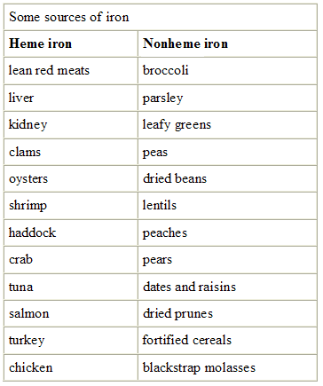

Slide 15
Enhancers of Iron absorption
Haem iron.
Proteins.
Meat.
Ascorbic acid.
Fermentation.
Ferrous iron.
Gastric acidity.
Alcohol.
Low iron stores.

Slide 16
Inhibitors of iron absorption:
Phytates.
Calcium.
Tannins.
Tea & Coffee.
Herbal drinks.
Fortified iron supplement.

Slide 17
Iron demand in pregnancy - 900 mg
Uterus and its contents -500-600mg
Loss at delivery - 150-200mg
Increased RBC mass - 500mg (returned to stores after delivery)
Saved due to amenorrhoea - 225mg

Slide 18
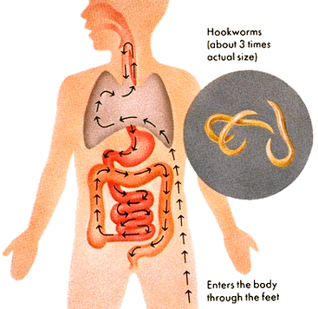
Iron loss:
Physiological factors:
Basal losses from desquamation from intestines & skin.
Menstruation.
Delivery.
Lactation.
B. Pathological factors:
Hookworm infestation.
Haemorrhage from GIT.
Allergies.
Occult.

Slide 19
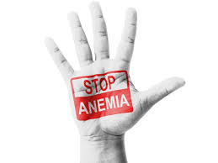
Prevention of iron deficiency:
WHO recommendations:
60 mg elemental iron
&
400 μg folic acid – once or twice a day.
(for 6 m antenatally and 3 m postnatally)
2. Government of India recommendations:
NATIONAL ANEMIA PROPHYLAXIS PROGRAMME
Elemental iron 100 mg with 500 μg of folic acid in the second half of pregnancy for a period of atleast 100 days.

Slide 20
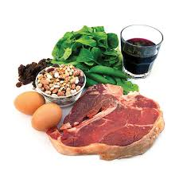
3. Treatment of Hookworm infestation:
T. Albendazole 400 mg single dose.
T. Mebendazole 100 mg Bd x 3 days.
4. Improvement of dietary habits.

Slide 21
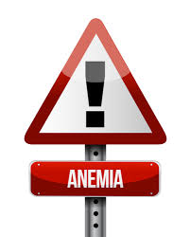
WIFS-2013
1)Objective-Weekly iron and folic acid supplementation to reduce prevalence and severity of anemia in adolescent population 10-19 yrs
2)Target groups-school going adolescent girls and boys in 6th -12th class enrolled in government/muncipal schools
Out of school adolescent girls
3)Intervention-
Weekly 100mg elemental iron and 500 microgram folic acid -using fixed day approach

Slide 22
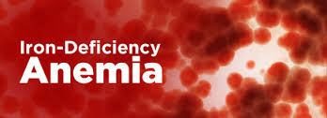
Effects of Anaemia on pregnancy:
Antenatal period
Preterm labour.
Preeclampsia.
Infection
Cardiac failure
Post natally
Puerperal sepsis.
Failure of lactation.
Subinvolution of uterus.
Thromboembolism.
Intrapartum
Uterine inertia
PPH
Cardiac failure
Shock

Slide 23
Effects of anaemia on fetus/new born:
Preterm birth.
Small for gestation age.
Perinatal morbidity & mortality.
Prone for infections.
Less of iron stores in these babies.

Slide 24
STAGES OF IRON DEFICIENCY
 | Normal values | Negative iron balance | Iron deficient erythropoises | Iron deficient anemia
Serum ferritin ( mcl/dl) | 50-200 | Decreased (<20) | Decreased (<15) | Decreased (<15)
Total iron binding capacity(mcg/dl) | 300-360 | Slight increase (>360) | Increased (>380) | Increased (>400)
Serum iron (mcg/dl) | 50-150 | normal | Decreased (<50) | Decreased (<30)
Transferrin saturation(%) | 30-50 | normal | Decreased (<20) | Decreased (<10)
RBC protoporphyrin (mcg/dl) | 30-50 | normal | Increased | Increased
Soluble transferrin receptor(mcg/L) | 4-9 | Increased | Increased | Increased
RBC morphology | Normal | Normal | Normal | Microcytic hypochromic

Slide 25
Clinical factors:
A. Symptoms
Mild anaemia & moderate anaemia –
- asymptomatic /weakness/fatigue/loss of appetite.
Severe anaemia –
- Palpitation, dyspnoea, giddiness, edema, anasarca & CCF.
B. Signs:
Pallor, glossitis, stomatitis, soft systolic murmur in mitral area, fine crepitations at lung bases due to congestion.

Slide 26
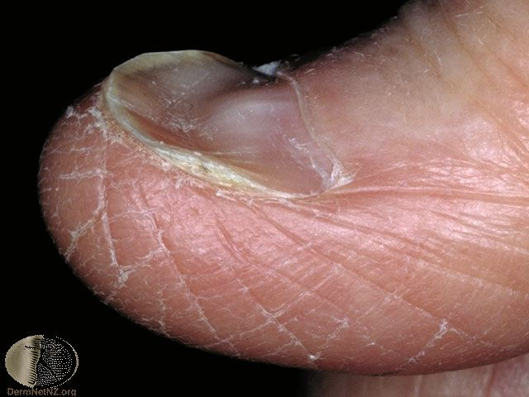
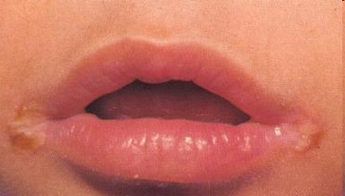
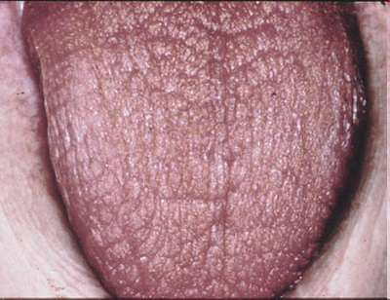
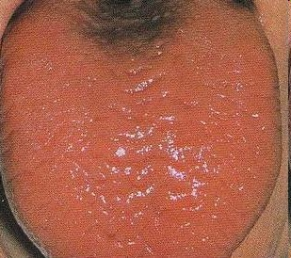
KOILONYCHIA CHELIOSIS
DRY MOUTH BRITTLE,ATROPHIC HAIR FALL
GLOSSITIS

Slide 27
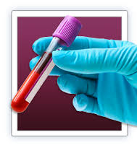
C. diagnosis:
Hb estimation
Peripheral blood smear
Red cell indices
S. Ferritin
S.Iron
TIBC
Percentage saturation

Slide 28
Red cell indices in Iron Deficiency and Thalassaemia
Characteristics | Normal range | Iron deficiency | Thalassaemia
MCV (fl) | 75 – 96 | Reduced | Very reduced
MCH (pg) | 27 – 33 | Reduced | Very reduced
MCHC (g/dl) | 32 – 35 | Reduced | Normal or slightly reduced
FEP (μg/dl) | < 35 | >50 | Normal
Red cell width |  | High | Normal

Slide 29
8. Bone marrow examination when there is no
response to iron therapy after 4 wks or for diagnosis
of suspected aplastic anaemia.
9. Stool examination for ova & cysts for consecutives 3
days.
10. Blood film for malarial parasites.
11. Serum proteins.

Slide 30
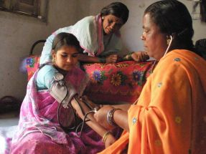
Management:
Oral iron
80-160 mg elemental iron is recommended, which results in increase in reticulocyte count with 5 – 10 days of start of oral therapy. Feeling of well being & improved look occurs. Hb increases by 0.2gm /dl /day.

Slide 31
Side effects:
GIT related – dose related.
Treatment with large doses continued until blood parameters become normal after which a maintenance dose of 1 tab/day is continued for atleast 3 months after delivery.
Disadvantages:
Non – compliance.
Intolerance.
Unpredictable absorption.

Slide 32
If there is no significant clinical or Haematological improvement with in 3 wks diagnostic reevaluation is needed. Reasons of failure to respond to oral therapy are,
Inaccurate diagnosis (non – iron deficiency microcytic anaemia such as thalassemia, pyridoxine deficiency & lead poisoning).
Non compliance.
Continuous loss of blood through hookworm infestation or bleeding haemorrhoids.
Concomitant folate deficiency.
Malabsorption of iron-celiac disease
Crohns, ulcerative colitis
Renal failure
Drugs

Slide 33
Parenteral therapy
Parenteral iron bypasses natural mechanism of intestinal uptake and associated protein binding
This allows free non protein bound iron to circulate which is toxic and leads to formation of hydroxide radicals and oxygen radicals.
cell and tissue damage due to peroxidation
Oral iron to be stopped before any parenteral iron therapy

Slide 34
Parental iron therapy:
Has no advantages over oral iron if later is well
tolerated.
Advantage of parenteral iron is certainity of
Administration.
Preparations available
Iron hydroxide sucrose complex
Iron dextran (imferon) – I.M/I.V
Iron sorbitol citrate (Jectofer) – I.M
Ferric carboxy maltose
Dosage – elemental iron (mg) needed =
(normal Hb – pts Hb) x wt (kg) x 2.21 + 1000.
or
250 mg elemental iron for each gm (Hb) below
normal.
Another 50% be added for stores.

Slide 35
INDICATIONS FOR PARENTERAL IRON THERAPY
Insufficient or no response to oral iron.
Severe anaemia in late 2nd trimester.
Insufficient absorption of oral iron due to intestinal disease.
The need for rapid efficacy.
Intolerance of oral iron.
Poor compliance.

Slide 36
Severe anaemia
30 – 36 wks > 36 wks.
G. Age < 30 wks
Oral therapy parenteral Blood
iron transfusion
Intolerance
or
Non compliance
I.M iron I.V. iron

Slide 37
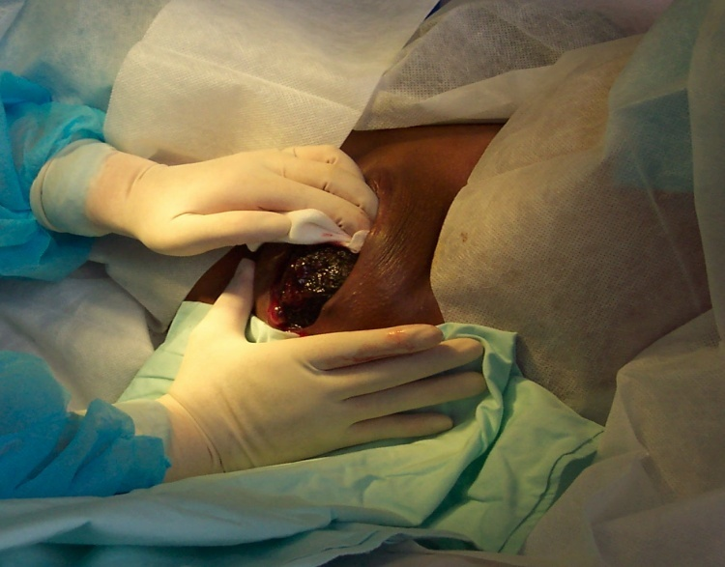
Labour in anaemic patient:
I stage:
Comfortable position.
Sedation & pain relief.
O2 kept ready.
Antibiotics prophylaxis to be given.
Digitalisation required in cardiac failure.
II stage:
Stressful with danger of CCF.
Outlet forceps.

Slide 38
III stage:
Active management done . Remember to energetically treat any PPH.
Puerperium: Continue iron & folate for atleast 6 months.
Contraception:
2 yrs.

Slide 39
Megaloblastic anaemias in pregnancy:
Deficiency of folate or vitamin B12.
DNA replication is affected.
Red cell maturation is deranged.
Megaloblasts seen (abnormal precursors).

Slide 40
Folate deficiency megaloblastic anaemia:
Folic acid
Didrofolic acid
Tetrahydro folic acid (required for cell growth & division)
Requirement is increased in pregnancy.

Slide 41
Folate deficiency:
Dietary deficiency is the main cause, prolonged cooking destroys the vitamin & to remember that reserves of folate are low. Malabsorption could be other cause.
Antifolate medication (phenytoin) can cause folate deficiency.
3. Folate requirements are increased by Iron therapy in Iron deficiency anaemia. So Iron & folate be given for better results.

Slide 42
Clinical factors:
Asymptomatic/loss of apetite/vomiting/diarrhoea/or unexplained fever /pallor /hepatospleenomegaly/ polyneuropathy.
Effects of pregnancy:
Increased incidence of abortion, IUGR, abruptio placentae, preeclampsia.
Effects on fetus:
NTD can be prevented in some cases by periconceptional folic acid at 400 μg (0.4 mg/d) in low risk cases & 5 mg/day in high risk women.

Slide 43
Peripheral smear:
Macrocytic anaemia with hypersegmentation of neutrophilis, neutropenia & thrombocytopenia.
Serum folate
Red cell folate
S. Iron normal.
Serum LDH & Haemocysteine

Slide 44
Prophylaxis:
Folate 500 μg /d during pregnancy.
Folate 500 μg /d during Lactation.
To eat more vegetables & animal liver/kidney.
Treatment:
5 mg/d – continued for 4 wks postpartum.

Slide 45
Dimorphic anaemia

Slide 46
Dimorphic anaemia:
(Deficiency of both Iron & folate megaloblastic bone marrow).
Peripheral smear:
Macrocytic or normocytic.
Normochromic or hypochromic picture.

Slide 47
THANK YOU

